Slide 1
Final Presentation Calibration of Deep Neural Networks
Students: Yonatan Leibovich, Avichay Ashur
Supervisor: Yair Moshe
Semester: Winter, 2023-2024
Date: 17/07/2024
Notes:
Present ourselves

Slide 2
Outline
Background, Project goal and literature survey
Problem reproduction
Calibration for audio classification network
Conclusions
Notes:
Just go other the bullets

Slide 3
Outline
Background, Project goal and literature survey
Problem reproduction
Calibration for audio classification network
Conclusions

Slide 4
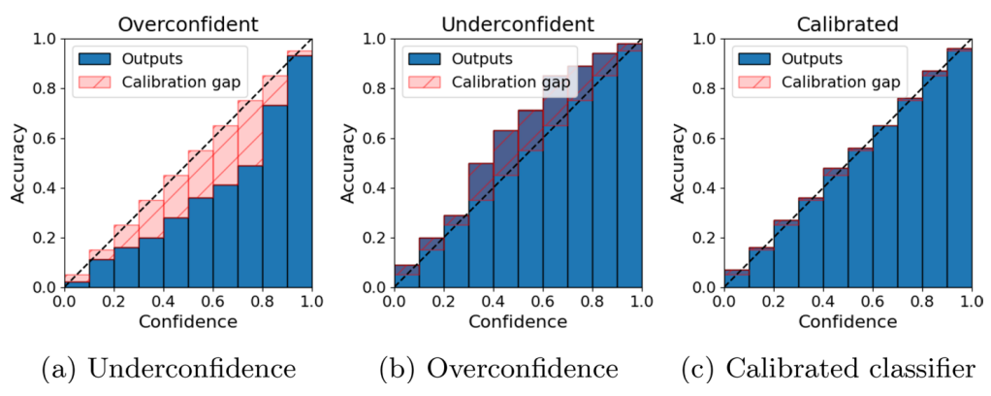
Background
(0.4,0.5)
(0.4,0.4)
(0.4,0.2)
$$Calibrated Model≠Accurated Model$$
Gawlikowski Jakob, et al., 2023
Notes:
Avichay:
As DNNs became more complex and had more hidden layers, the outputs of the model became less calibrated:
$$MissCalibration\left(DNN\right)=\left|Prediction_Confidence −Actual Probability\right|$$
Where the prediction confidence is score of the predicted class:
$$\max\left\{p | ∨p∈dnn_output_vector\right\}$$
And the actual probability is calculated using binning techniques.
Point out to the meaning of the graph: for example if accuracy in confidence 0.6 is lower 0.6 -> overconfident
Calibrated model doesn’t equal accurated model – cancer example

Slide 5
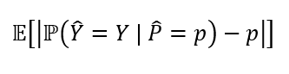
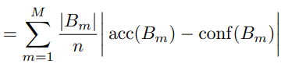
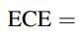
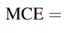
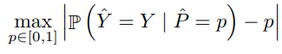
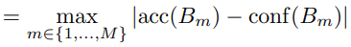
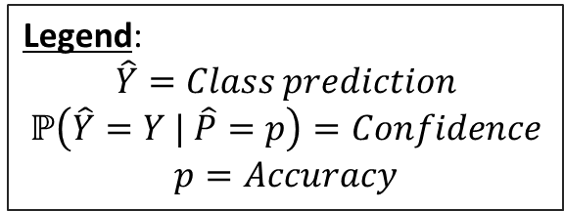
Network Calibration Metrics
Common calibration metrics:
Expected Calibration Error (ECE):
Maximum Calibration Error (MCE):
Legend:
$$\hat{Y}=Class prediction$$
$$ℙ\left(\hat{Y}=Y | \hat{P}=p\right)=Confidence$$
$$p=Accuracy$$
Notes:
Avichay:
Two examples for metrics which calculate miscalibration.
We chose to work with ECE which is more commonly used in the papers
Explain that this is the sum of the absolute value of the differences in the previous graph – normalized.

Slide 6
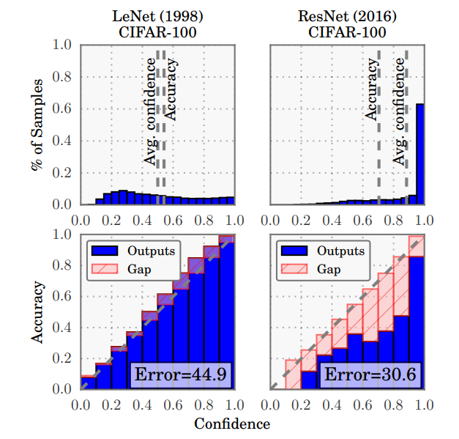
Overconfidence
DNN models in the past used to be calibrated:
LeNet (1998) is well calibrated (<5%)
DNN models in the last decade suffer from overconfidence:
ResNet (2016) is not well calibrated (<16%)
Guo, Chuan, et al., 2017
Notes:
Avichay:
Comparing nets from the past to today:
In the past we had more calibrated networks
Today they are overconfident
Go other the numbers in the slide

Slide 7
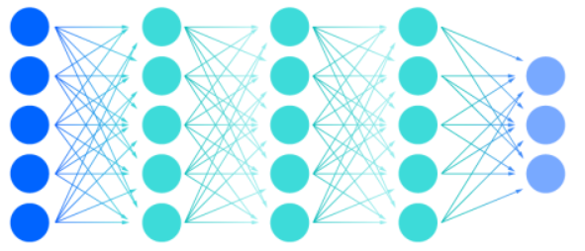
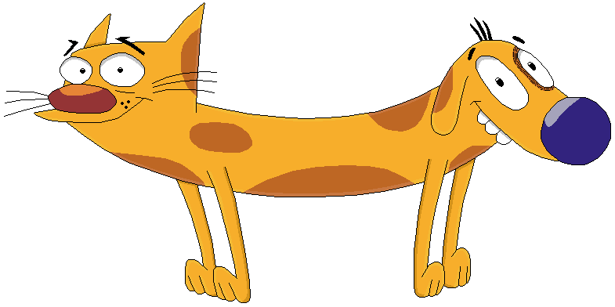
Network Calibration
80% Cat!
Are you sure?
Notes:
Yonatan:
Deep Neural Networks (DNN) are suffering from misscalibration - the model’s confidence in it’s prediction doesn’t match the actual probability.
For example if we have 100 pictures which the network gives 0.8 score that it is a cat – we expect 80 of the pictures to actually be cats. Actual accuracy is usually lower.
This is not like in the past with more shallow networks.
Several methods have been proposed to solve this in literature for DNN of image classification.
Accuracy and correct probabilities are important in several fields, one prime example is the medical field (Saying to a patient for example he has 80% cancer or 99% cancer matters)
Our goal – to test and compare the main calibration methods on Audio Classification DNNs.

Slide 8
Project Goals
Learn and understand state-of-the-art calibration methods for DNNs.
Test and compare the main calibration methods on Audio Classification DNNs.
Notes:
Yonatan:
Just go through the bullets.
No papers found on audio classification – which is why we want to investigate this issue.

Slide 9
Reasons for Uncertainty
Two factors affect the uncertainty of a network:
Data Uncertainty
Model Uncertainty
Notes:
Avichay:
In general there are two factors to uncertainty:
Data uncertainty – which is related to the data we collected. The more data we collect the more likely this uncertainty will go down (not always but in general)
Model Uncertainty – Mostly affected by the architecture and the training time – The more complex our model, the more likely this uncertainty will go down.

Slide 10
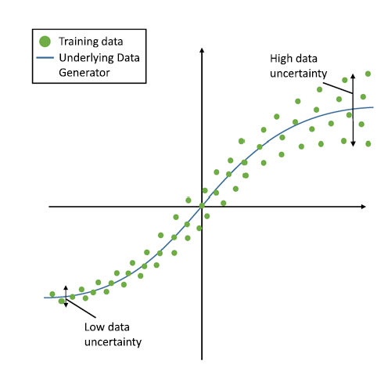
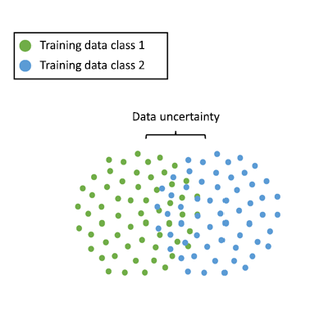
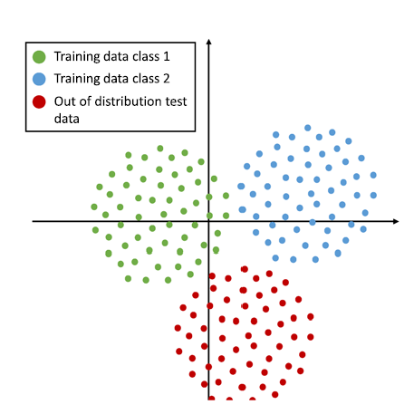
Data Uncertainty
Notes:
Avichay:
Different examples of how data distribution affects the model:
Example 1: Talk about the correlation between the variance of the data with the uncertainty
Example 2: Think about if we want to keep
Example 3: Out of knowledge domain prediction – model can be very inaccurate there
Example 4: Data itself is not divided in a clear manner – affects the data distribution
Example 5: Much like example 3
Example 6: Another out of data example
Not much to do about data uncerteinity - Explain that actual data is very high dimensionality so this is very hard to predict

Slide 11
Model Uncertainty
Model Ensemble
Batch Norm
Model Uncertainty
Data Shuffling
Dropout
Notes:
Avichay:
Go other each bubble and explain how it helps to reduce data uncertainty
No optimal universal solution found yet

Slide 12



Possible Solutions
Post Processing Methods
During Training
Uncertainty removal
Notes:
Yonatan:
Now that we have a common language
Here we start discussing the project itself.
There are a few solutions to the problem suggested in the literature:
Post processing methods
During-training methods – Regulation– regulation is for example adding calibration error to loss function
Uncertainty removal
We are focused on post processing methods in our project.
We went on post processing because:
the other methods have shown to have a negative impact on the accuracy
We want to apply on existing networks

Slide 13
Post Processing Methods
Post processing demands:
Ease of application
Only affect calibration
Optimization of target function (i.e., ECE)
Notes:
Yonatan:
Post processing demands:
Post processing should be relatively easy to apply
Should not affect class prediction i.e. should not manipulate accuracy
Should minimize miscalibration metrics such as ECE
Spoiler – one method we found that answers all criteria’s is called temperature scaling.
Mix n match – read about it

Slide 14
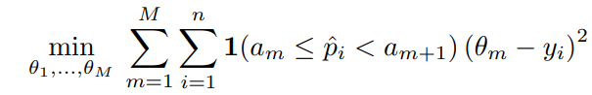
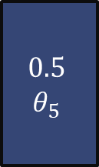
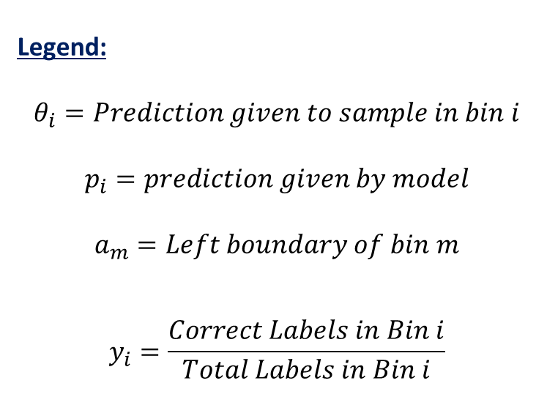
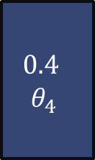
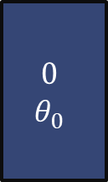
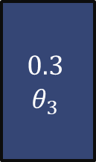
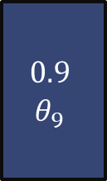
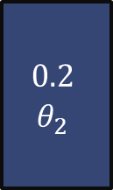
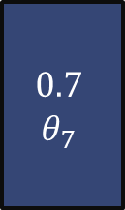
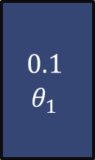
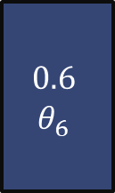
Post Processing Methods
Legend:
$$θ_{i}=Prediction given to sample in bin i$$
$$p_{i}=prediction given by model$$
$$a_{m}=Left boundary of bin m$$
$$y_{i}=\frac{Correct Labels in Bin i}{Total Labels in Bin i}$$
Histogram Binning:
$$0$$
$$θ_{0}$$
$$0.1$$
$$θ_{1}$$
$$0.2$$
$$θ_{2}$$
$$0.3$$
$$θ_{3}$$
$$0.4$$
$$θ_{4}$$
$$0.5$$
$$θ_{5}$$
$$0.6$$
$$θ_{6}$$
$$0.7$$
$$θ_{7}$$
$$0.9$$
$$θ_{9}$$
Guo, Chuan, et al., 2017
Notes:
Yonatan:
Explain about the slide
Mention that this is an example of a binary classification – Can be expanded to multiclass
Read about how it can be expanded to multiclass

Slide 15
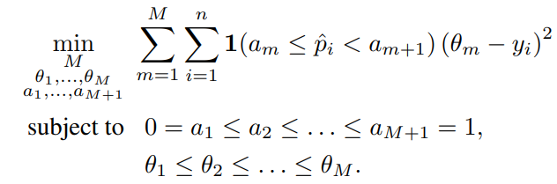

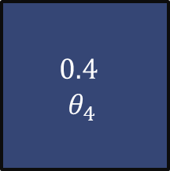

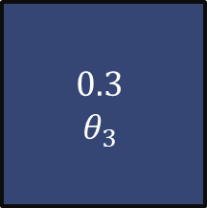
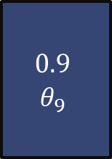
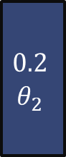

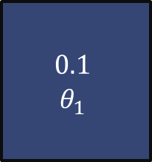
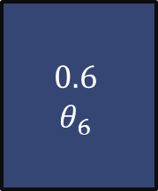
Post Processing Methods
Legend:
$$θ_{i}=Prediction given to sample in bin i$$
$$p_{i}=prediction given by model$$
$$a_{m}=Left boundary of bin m$$
$$y_{i}=\frac{Correct Labels in Bin i}{Total Labels in Bin i}$$
Isotonic Regression:
$$0$$
$$θ_{0}$$
$$0.1$$
$$θ_{1}$$
$$0.2$$
$$θ_{2}$$
$$0.3$$
$$θ_{3}$$
$$0.4$$
$$θ_{4}$$
$$0.5$$
$$θ_{5}$$
$$0.6$$
$$θ_{6}$$
$$0.7$$
$$θ_{7}$$
$$0.9$$
$$θ_{9}$$
Guo, Chuan, et al., 2017
Notes:
Yonatan:
Explain about the slide
Compare with previous slide about the change in bin size
Mention that this is an example of a binary classification – Can be expanded to multiclass
Read about how it can be expanded to multiclass

Slide 16
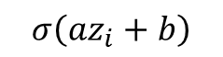

Post Processing Methods
Platt Calibration:
$$Z_{i}$$
$$σ\left(az_{i}+b\right)$$
Guo, Chuan, et al., 2017
Notes:
Yonatan:
Explain about the slide
Think about if we want to talk about vector and matrix scaling

Slide 17
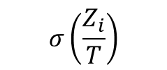
Post Processing Methods
Accuracy is untouched.
T > 1 → Model is less confident
T = 1 → Original model confidence.
T < 1 → Model is more confident
Temperature Scaling:
$$σ\left(\frac{Z_{i}}{T}\right)$$
$$Z_{i}$$
Guo, Chuan, et al., 2017
Notes:
Yonatan:
Explain about the slide

Slide 18
Outline
Background, Project goal and literature survey
Problem reproduction
Calibration for audio classification network
Conclusions

Slide 19
Method of Work
Training
DNN Training
Uncalibrated labels
Calibration
Audio DB
Calibrated Model
Inference
Calibrated Model
Data Sample
Label
Notes:
Yonatan:
We will take some trained networks and some we will train ourselves
The main block is the calibration of the prediction scores – this is where our project aims to act upon
In the inference stage we will compare the results and make our conclusions
Our project is mainly focused on the green cube of the calibration

Slide 20
Reproducing the Problem
(Guo et al., 2017) achieved an uncalibrated ECE of 10-16% on the CIFAR-100 dataset*.
We selected DenseNet and used Calibration Network package to reproduce the problem**.
**Küppers, et al., 2022
*Guo, Chuan, et al., 2017
Notes:
Avichay:

Slide 21
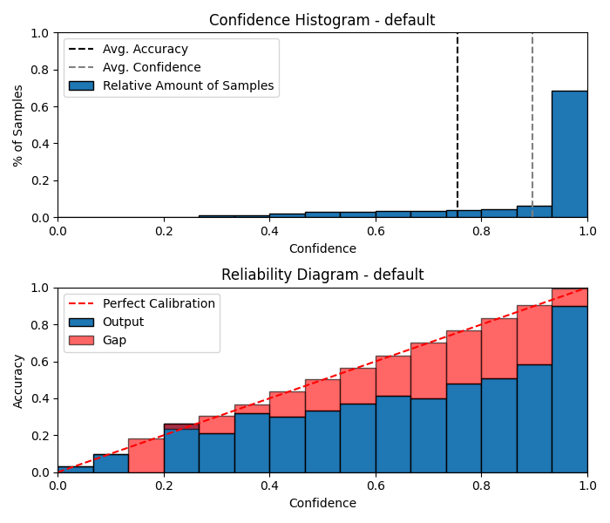
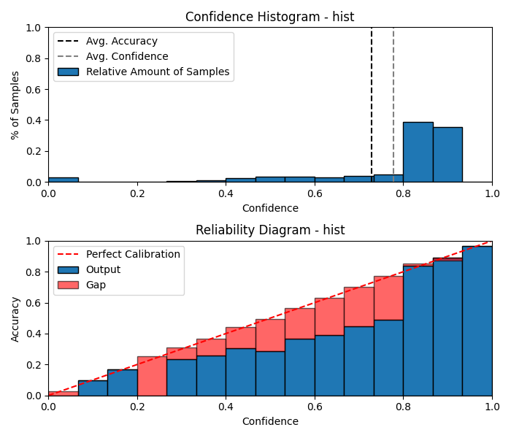
Reproducing the Problem
ECE = 14.2%
ECE = 7.6%
Acc: 0.754
Conf: 0.89
Acc: 0.731
Conf: 0.77
Guo, Chuan, et al., 2017
Notes:
Avichay:
Left is uncalibrated – suffers from large error in ECE
Right is histogram binning which reduced ECE but also confidence

Slide 22
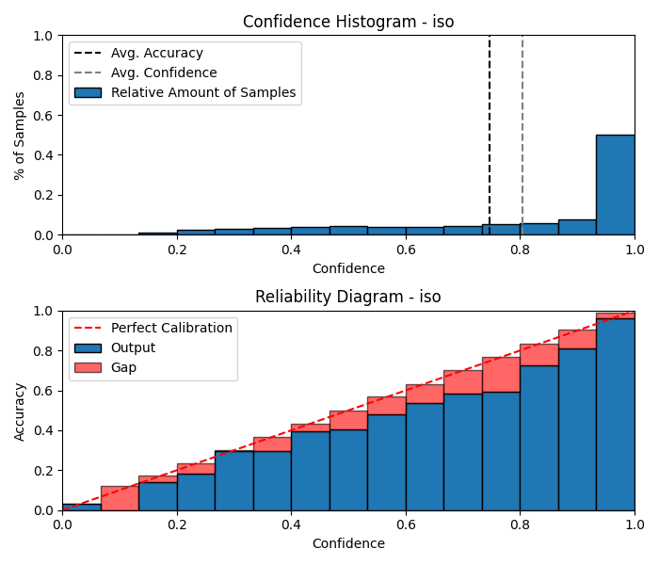
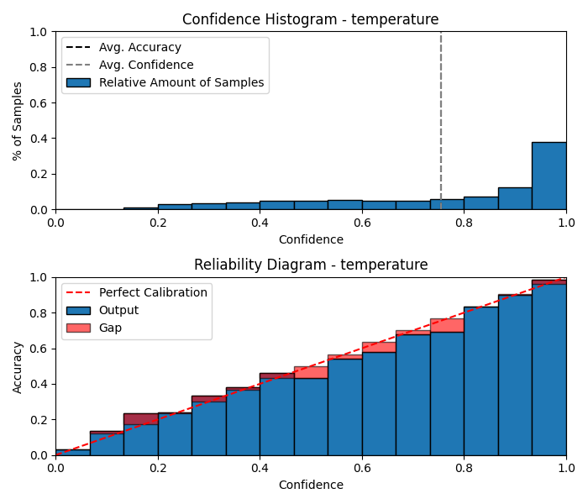
Reproducing the Problem
ECE = 4.7%
ECE = 2.6%
Acc: 0.749
Conf: 0.8
Acc: 0.754
Conf: 0.755
Temperature=0.5
Guo, Chuan, et al., 2017
Notes:
Avichay

Slide 23
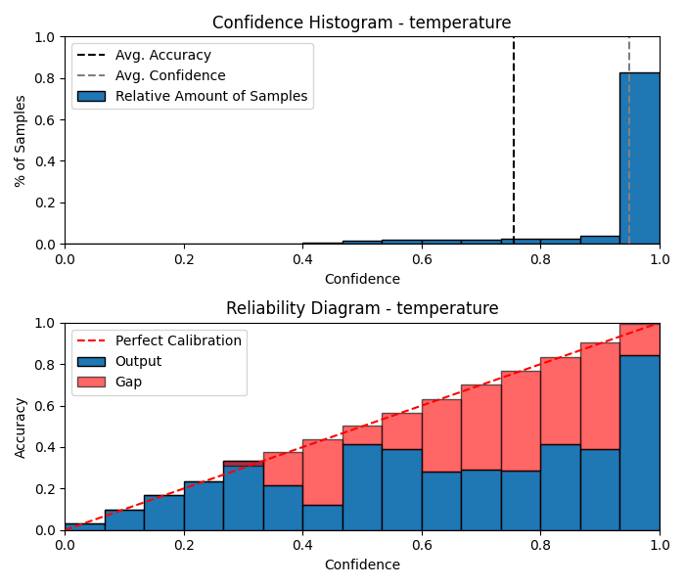
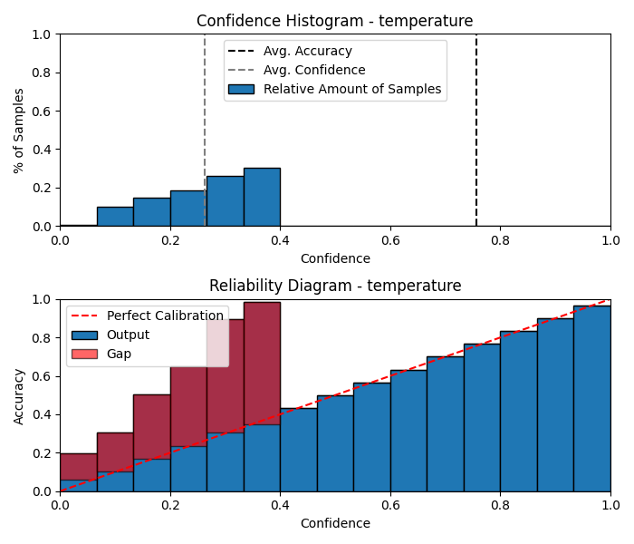
Reproducing the Problem
ECE = 19.6%
ECE = 49.2%
Acc: 0.754
Conf: 0.955
Conf: 0.268
Acc: 0.754
Temperature = 2
Temperature=0.25
Guo, Chuan, et al., 2017
Notes:
Avichay:

Slide 24
Reproducing the Problem – Results
Our Results | Guo, Chuan, et al., 2017 | Calibration Method
14.25% | 10.37% | Uncalibrated
7.64% | 2.68% | Histogram Bins
4.7% | 4.51% | Isotonic
2.6% | 1.18% | Temperature Scaling
Metric used: ECE
Notes:
Avichay:

Slide 25
Outline
Background, Project goal and literature survey
Problem reproduction
Calibration for audio classification network
Conclusions

Slide 26
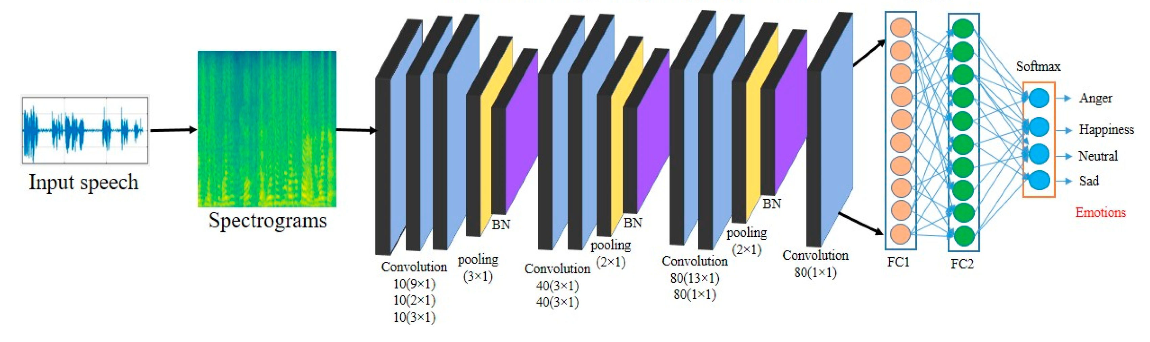
Using CNN on Audio
Notes:
Yonatan:
One method which is widely used to classify audio nets is to turn audio to spectrograms and insert as image to CNN

Slide 27
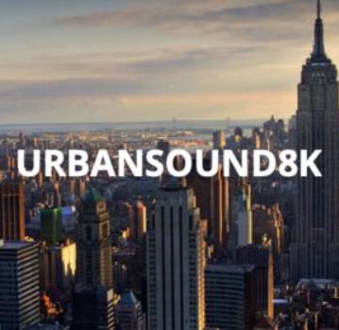

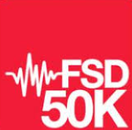

Chosen Datasets
UrbanSound8K
ESC-50
FSD50K
Dcase-2017
UrbanSound8K:
10 Classes
8,732 Data Samples
ESC-50:
50 Classes
2,000 Data Samples
FSD50K:
3,935 Classes
51,197 Data Samples
DCASE-2017:
15 Classes
4,680 Data Samples
Notes:
Yonatan

Slide 28
Chosen Datasets – Characteristics
Samples/Class | Balanced | Data Samples | Num Classes | Dataset
1000 | Yes | 8,732 | 10 | Urban8k
40 | Yes | 2,000 | 50 | ESC-50
Vary | No | 51,197 | 200 Class – 3935 Sub Class | FSD-50K
~300 | No | 4,680 | 15 | DCASE-2017
Notes:
Yonatan

Slide 29
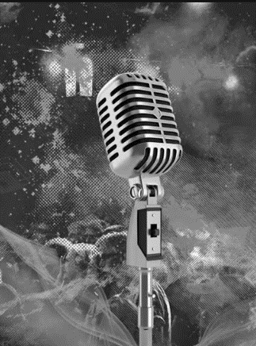
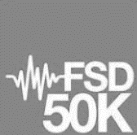

UrbanSound8K
UrbanSound8K
ESC-50
FSD50K
Dcase-2017
UrbanSound8K:
10 Classes
8,732 Data Samples
ESC-50:
50 Classes
2,000 Data Samples
FSD50K:
3,935 Classes
51,197 Data Samples
DCASE-2017:
15 Classes
4,680 Data Samples
Notes:
Avichay

Slide 30
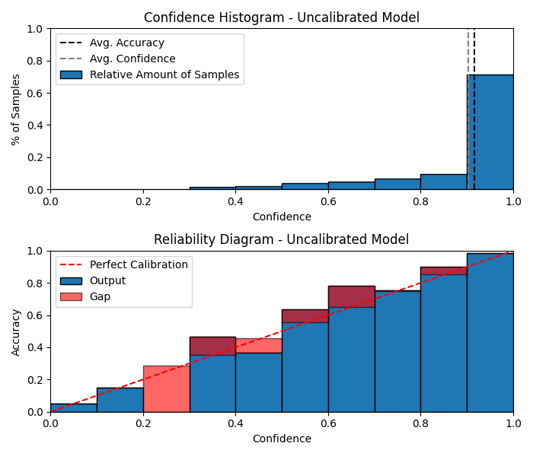
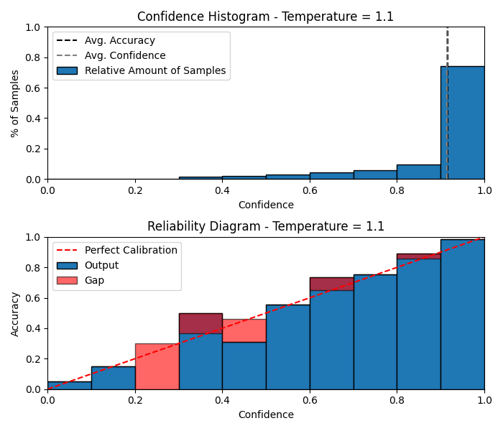
Urban8K – Results
Urban8K – Gurbuz Network Uncalibrated
Urban8K – Gurbuz Network Temperature Scaling Calibration
*10 Layers, CNN Based combined with Max and average Pooling and dropout.
Notes:
Avichay

Slide 31
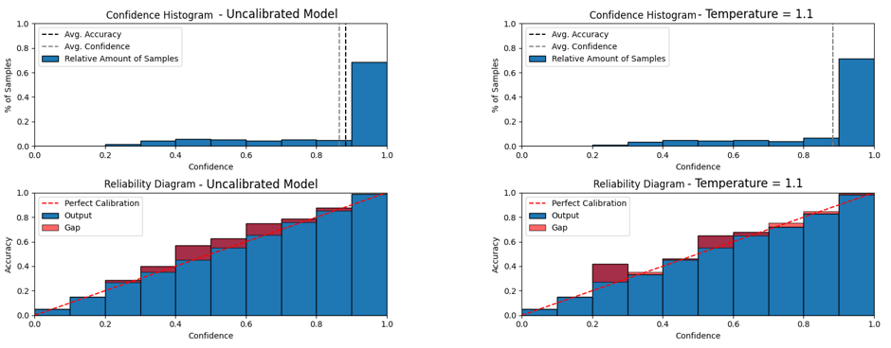
Urban8K – Results
Urban8K – Nitish Network Uncalibrated
Urban8K – Nitish Network Temperature Scaling Calibration
*10 Layers, Fully connected Architecture combined with dropout and ReLU activation.
Notes:
Avichay

Slide 32
Chosen Datasets – Results
Temp Scaling ECE | Over/Under Confidence | Uncalibrated ECE | Accuracy | Network | Dataset
1.3% | Under | 1.8% | 91.64% | Gurbuz | Urban8k
1.5% | Under | 2.2% | 88.24% | Nitish | Urban8k
Notes:
Avichay

Slide 33
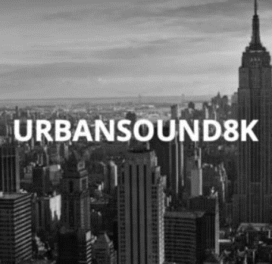

UrbanSound8K
UrbanSound8K
ESC-50
FSD50K
Dcase-2017
UrbanSound8K:
10 Classes
8,732 Data Samples
ESC-50:
50 Classes
2,000 Data Samples
FSD50K:
3,935 Classes
51,197 Data Samples
DCASE-2017:
15 Classes
4,680 Data Samples
Notes:
Avichay

Slide 34
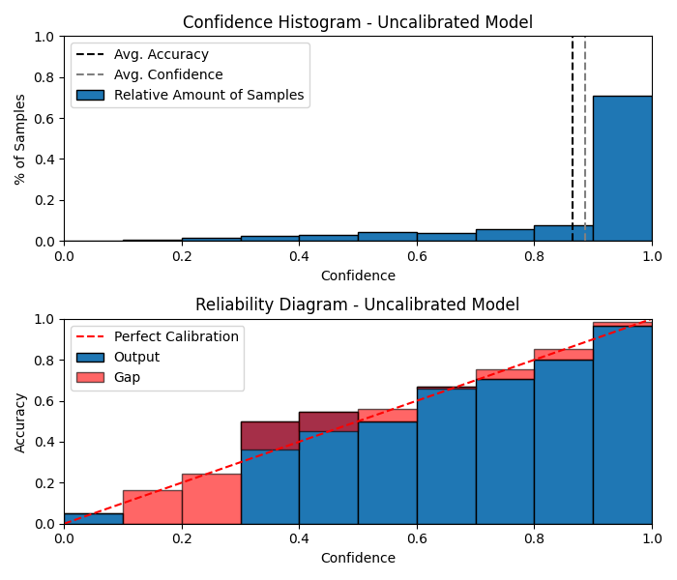

ESC-50 – Results
ESC-50 – YAMNet Network Uncalibrated
ESC-50 – YAMNet Network Temperature Scaling Calibration
*15 Layers, CNN Based combined with maxpool and dropout.
Notes:
Avichay

Slide 35

ESC-50 – Results
ESC-50 – ResNet Network Uncalibrated
ESC-50 – ResNet Network Temperature Scaling Calibration
*ResNet-18 – Resnet with 18 layers
Notes:
Avichay

Slide 36
Chosen Datasets – Results
Temp Scaling ECE | Over/Under Confidence | Uncalibrated ECE | Accuracy | Network | Dataset
1.3% | Under | 1.8% | 91.64% | Gurbuz | Urban8k
1.5% | Under | 2.2% | 88.24% | Nitish | Urban8k
4.2% | Over | 13.4% | 78.3% | ResNet | ESC-50
1.7% | Over | 2.6% | 86% | YAMNet | ESC-50
Notes:
Avichay

Slide 37

FSD-50K
UrbanSound8K
ESC-50
FSD50K
Dcase-2017
UrbanSound8K:
10 Classes
8,732 Data Samples
ESC-50:
50 Classes
2,000 Data Samples
FSD50K:
3,935 Classes
51,197 Data Samples
DCASE-2017:
15 Classes
4,680 Data Samples
Notes:
Yonatan

Slide 38


FSD-50K – Results
FSD-50K – CNN Network Uncalibrated
FSD-50K – CNN Network Temperature Scaling Calibration
*3 Layers, CNN Based combined with maxpool and dropout.
Notes:
Yonatan

Slide 39

DCASE-2017
UrbanSound8K
ESC-50
FSD50K
Dcase-2017
UrbanSound8K:
10 Classes
8,732 Data Samples
ESC-50:
50 Classes
2,000 Data Samples
FSD50K:
3,935 Classes
51,197 Data Samples
DCASE-2017:
15 Classes
4,680 Data Samples
Notes:
Yonatan

Slide 40

DCASE-2017 – Results
DCASE-2017 – CNN Network Uncalibrated
DCASE-2017 – CNN Network Temperature Scaling Calibration
*3 Layers, CNN Based combined with maxpool and dropout.
Notes:
Yonatan

Slide 41


Isotonic calibration for DCASE-2017 Interesting case of improvement in Acc and ECE
DCASE – CNN
Uncalibrated
ECE: 4%
Acc: 91%
DCASE – CNN
ISOTONIC
ECE: 1%
Acc: 95%
Notes:
Yonatan

Slide 42
Results Summary
Temp Scaling ECE | Over/Under Confidence | Uncalibrated ECE | Accuracy | Network | Dataset
1.3% | Under | 1.8% | 91.64% | Gurbuz | Urban8k
1.5% | Under | 2.2% | 88.24% | Nitish | Urban8k
4.9% | Over | 13.4% | 78.3% | ResNet* | ESC-50
2.2% | Over | 2.6% | 86% | YAMNet | ESC-50
1.25% | Over | 6.38% | 87.19% | CNN* | FSD-50k
2.39% | Over | 4.41% | 91.13% | CNN* | Dcase-2017
* Self trained network
Notes:
Yonatan

Slide 43
More Experiments
Initial results show miscalibration happen in audio data sets.
We’ve chosen to run tests on both DCASE and FSD50k to investigate how hyper-parameter values of the model affect miscalibration:
Accuracy
Dataset size
Miscalibration size
Number of classes
Number of epochs
Notes:
Yonatan

Slide 44

FSD50K – Experiment 1 Miscalibration as a function of accuracy
*All models were initiated with the same weights
Notes:
Yonatan

Slide 45



DCASE – Experiment 2 ECE as a function of number of epochs
*All models were initiated with the same weights
Notes:
Yonatan

Slide 46



DCASE – Experiment 3 ECE as a function of number of classes
*All models were initiated with the same weights
Notes:
Yonatan

Slide 47


FSD50K – Experiment 4 Miscalibration as a function of class imbalance
*All models were initiated with the same weights
Notes:
Yonatan

Slide 48

FSD50K – Experiment 5 Miscalibration as a function of dataset size
*All models were initiated with the same weights
Notes:
Yonatan

Slide 49
Outline
Background, Project goal and literature survey
Problem reproduction
Calibration for audio classification network
Conclusions

Slide 50
Conclusions
Miscalibration for Audio: Calibration issues have been observed to significantly impact the audio field, aligning with earlier predictions.
Dataset Distribution and Network Calibration: Network calibration appears to be sensitive to variations in dataset distribution.
Notes:
Avichay

Slide 51
Conclusions
Calibration Effects on Confidence Levels: Networks often exhibit both over and under confidence. Implementing isotonic or histogram calibration methods might improve both accuracy and calibration reliability.
Hyperparameter values and Calibration: The choice of hyperparameter values (e.g., number of epochs, batch size) can significantly influence network calibration.
Notes:
Avichay

Slide 52
References
Guo, Chuan, et al. "On calibration of modern neural networks." International conference on machine learning. PMLR, 2017.
Gawlikowski, Jakob, et al. "A survey of uncertainty in deep neural networks." Artificial Intelligence Review 56.Suppl 1 (2023): 1513-1589.
Küppers, Fabian, Jonas Schneider, and Anselm Haselhoff. "Parametric and multivariate uncertainty calibration for regression and object detection." European Conference on Computer Vision. Cham: Springer Nature Switzerland, 2022.

